Slide 1

TELECOM CHURN PREDICTION
Powered by:
Lingxuan Zhang, Matthias Galipaud and Ruben Coll

Slide 2


Outline
1
Sector & Company
2
Objectives
3
Methodology
4
Results & Insights
5
Recommendations
Q&A

Slide 3


Sector & Company
Sector revenue: 270,2 Billion €
Number of employees: 1,002 Million
Avg. Churn Rate: 23%
GDP: 2.5%
Largest telecommunications company in Europe.
Number of Customers: 104.789
Market Share: 58%
Churn Rate: 27%
Retain a old customer is much cheaper than acquiring a new one.
Important note: All the figures shown above are completely invented and only used for educational purposes.

Slide 4
Objectives
“Your most unhappy customers are your greatest source of learning”
Bill Gates
Predicting which customers have high risk of discontinuing their subscriptions
Understanding the key drivers of the churn rate

Slide 5
Methodology
Business & Data Understanding
Data Collection & Cleaning
Data Exploration & Processing
Modeling & Evaluation

Slide 6
Methodology
Business & Data Understanding
Data Collection & Cleaning
Data Exploration & Processing
Modeling & Evaluation

Slide 7

Business & Data understanding
Why churn rate is important for the company?
Retain a old customer is much cheaper than acquiring a new one.
Which characteristics lead to a churn:
Gender?
Extra services?
Subscription Price?
Contract type?

Slide 8
Methodology
Business & Data Understanding
Data Collection & Cleaning
Data Exploration & Processing
Modeling & Evaluation

Slide 9


Data Collection & Cleaning
Data Collection
Data Cleaning
Source: Internal CRM (/Kaggle)
5.986 rows
21 features:
Demographic
Service
Billing
Check for inconsistencies in the data:
Null values
Outliers

Slide 10
Methodology
Business & Data Understanding
Data Collection & Cleaning
Data Exploration & Processing
Modeling & Evaluation

Slide 11
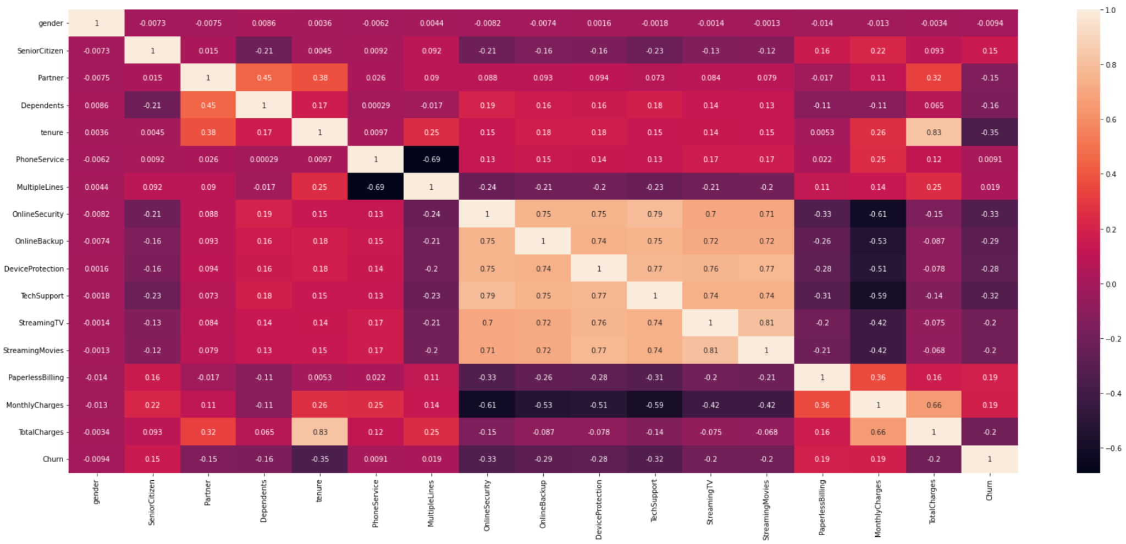
Data exploration

Slide 12
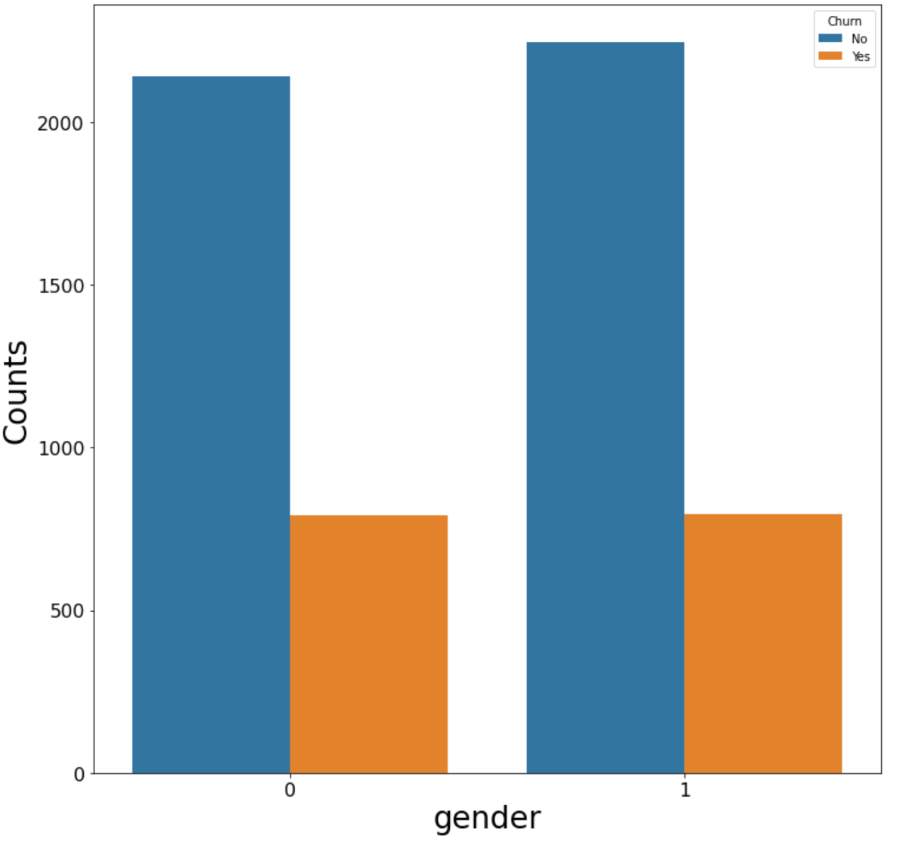
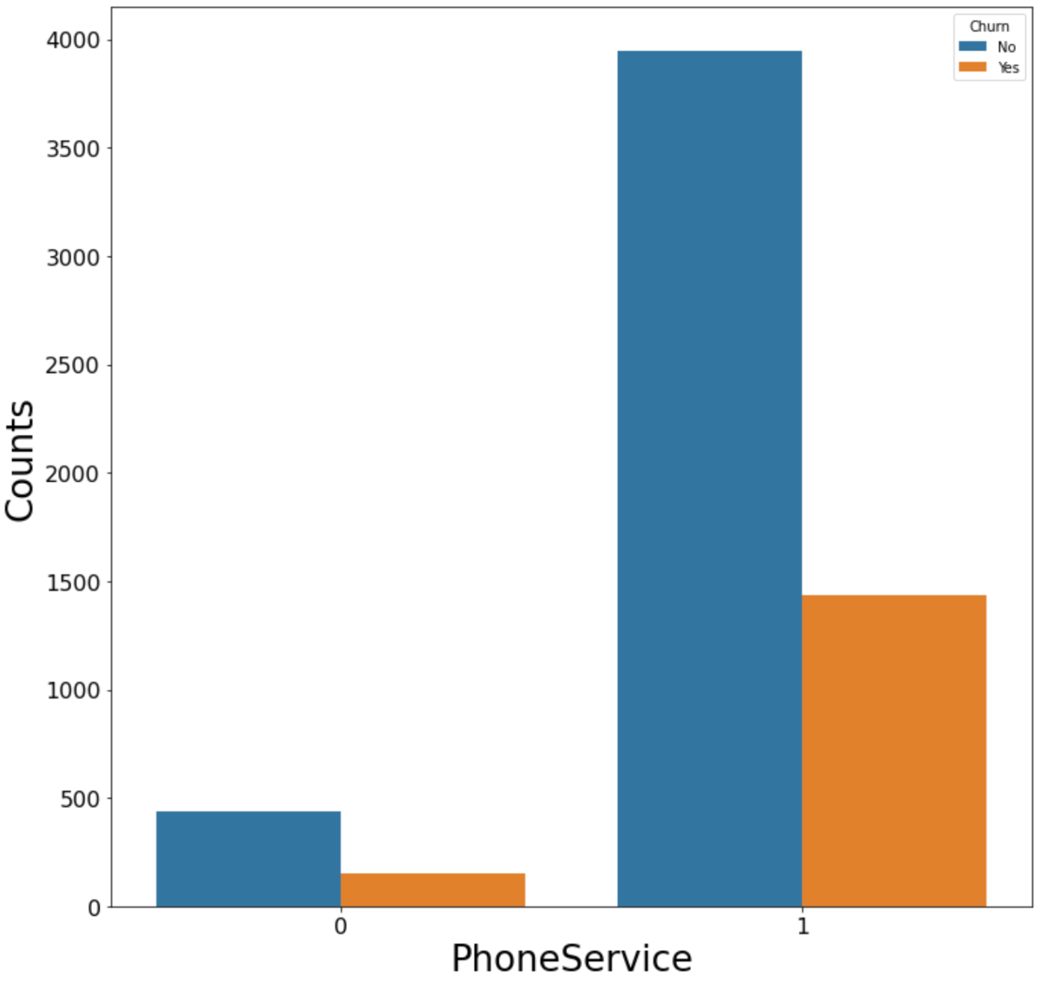
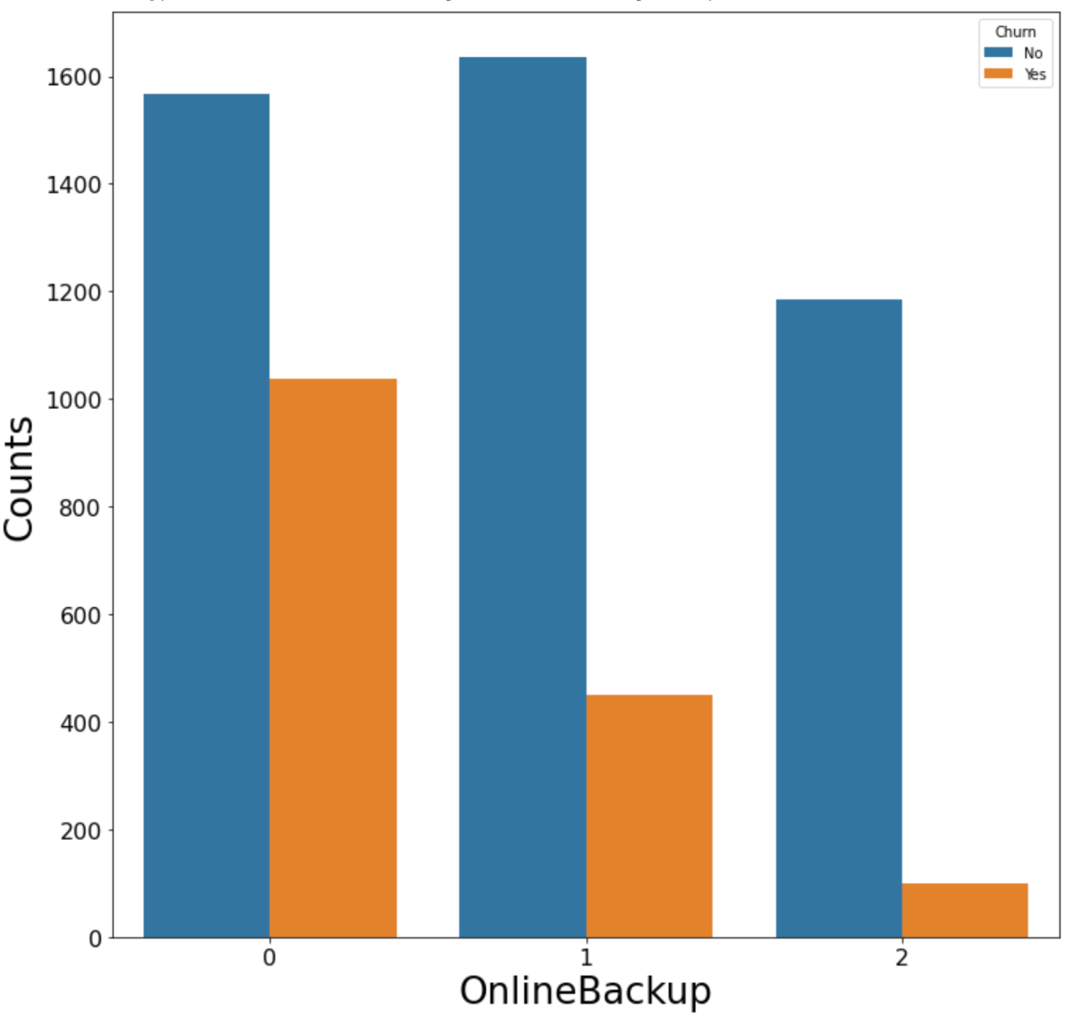
Data exploration

Slide 13
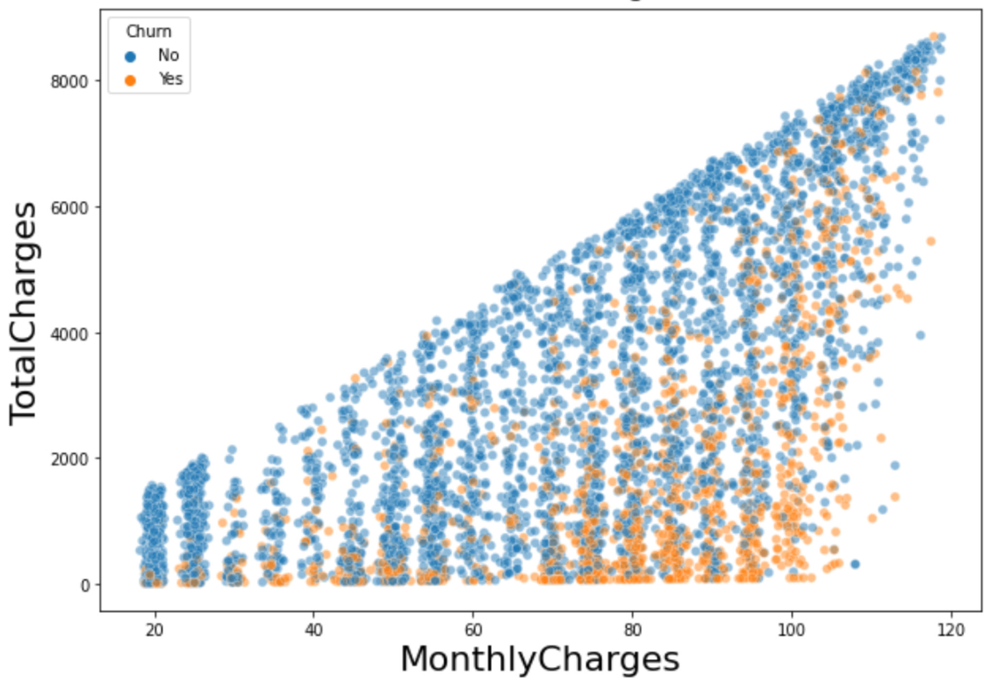
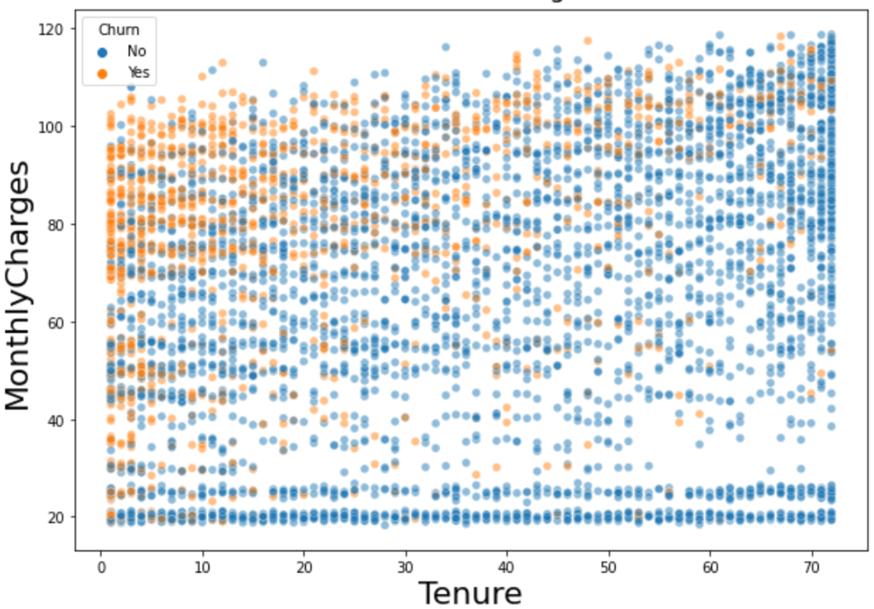
Data exploration

Slide 14
Methodology
Business & Data Understanding
Data Collection & Cleaning
Data Exploration & Processing
Modeling & Evaluation

Slide 15
Modeling and evaluation
 |  | Real Value
 |  | Churn | Retain
Predicted Value | Churn
 | Retain
TP
FP
FN
TN

Slide 16
Modeling and evaluation
 |  | Real Value
 |  | Churn | Retain
Predicted Value | Churn
 | Retain
TP
FP
FN
TN
Recall = TP / TP + FN

Slide 17
Modeling and evaluation
 |  | Real Value
 |  | Churn | Retain
Predicted Value | Churn
 | Retain
TP
FP
FN
TN
Precision = TP / TP + FP

Slide 18
A model to maximize recall
 |  | Real Value
 |  | Churn | Retain
Predicted Value | Churn
 | Retain
375
478
89
854
Recall = 0.81

Slide 19
A model to maximize recall
 |  | Real Value
 |  | Churn | Retain
Predicted Value | Churn
 | Retain
375
478
89
854
853 customers to call!!

Slide 20
A model to maximize precision
 |  | Real Value
 |  | Churn | Retain
Predicted Value | Churn
 | Retain
237
136
227
1196
373 customers to call
precision = 0.66

Slide 21
A model to maximize precision
 |  | Real Value
 |  | Churn | Retain
Predicted Value | Churn
 | Retain
237
136
227
1196
precision = 0.66
recall = 0.51

Slide 22
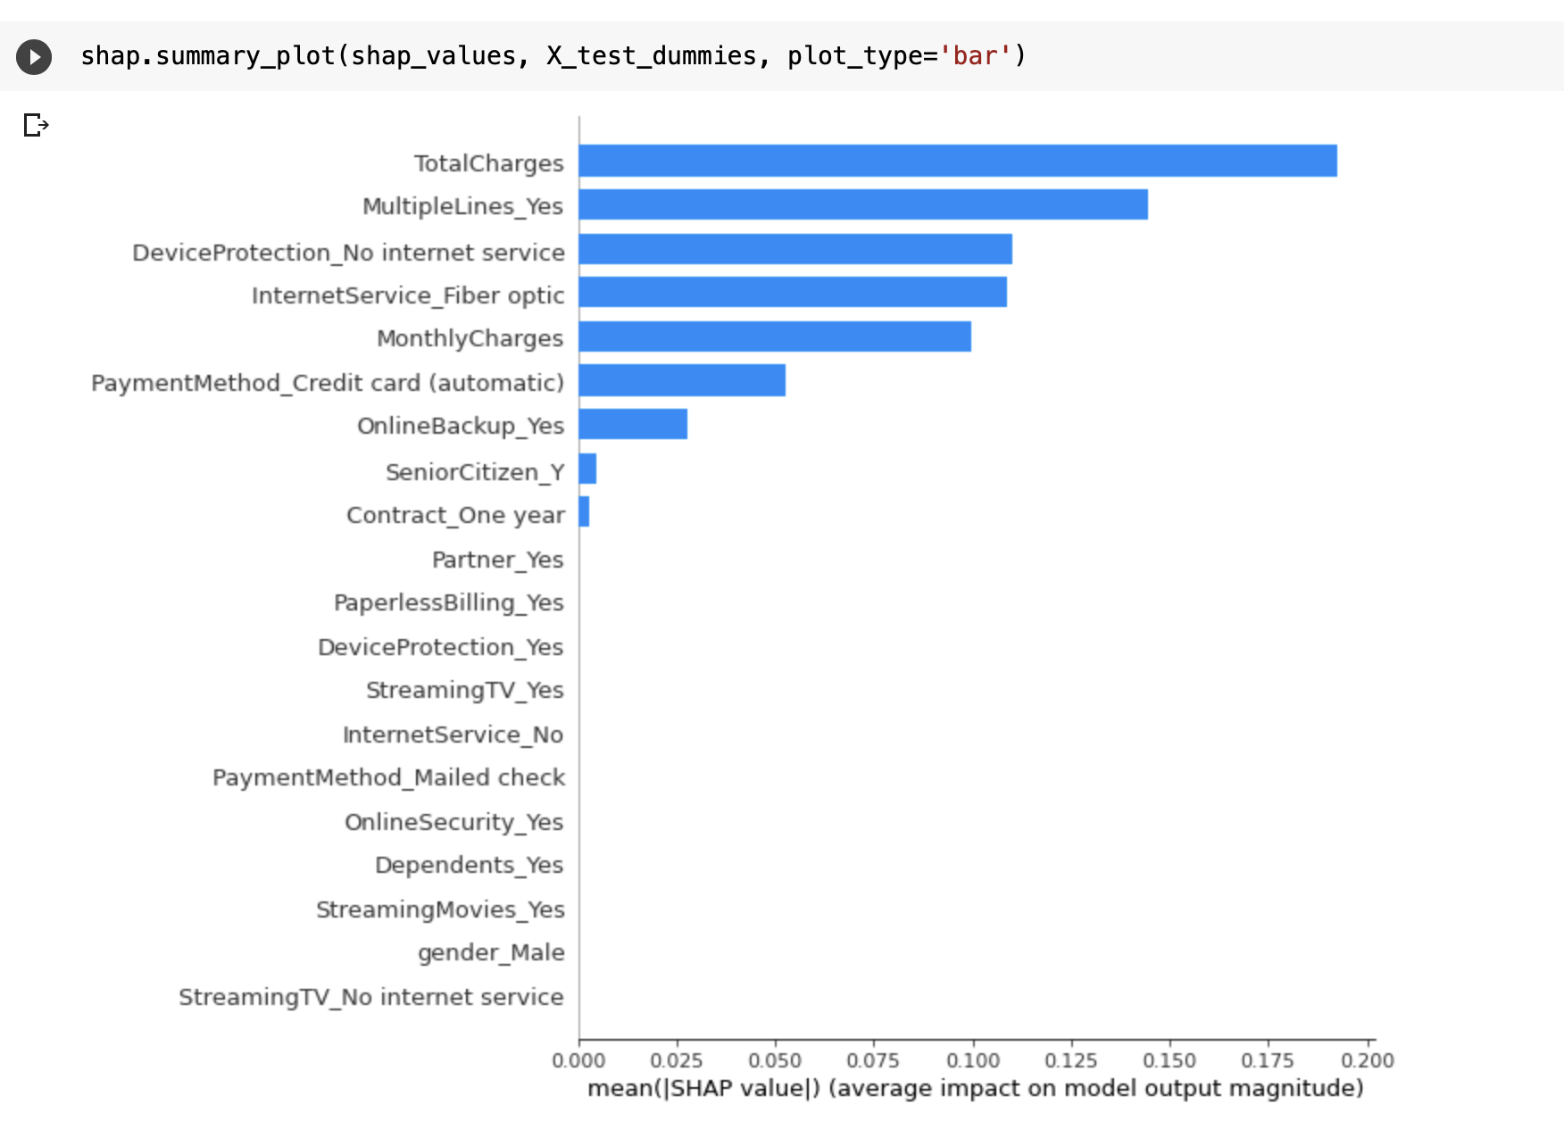
Results & Insights
Features

Slide 23
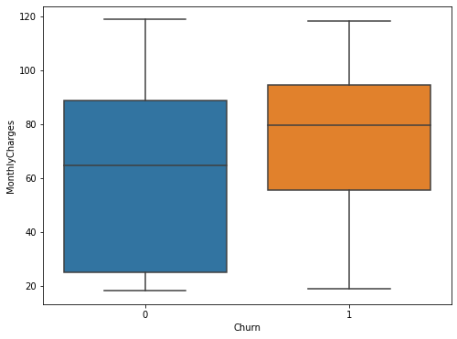
Churned customers pay more
No
Yes

Slide 24
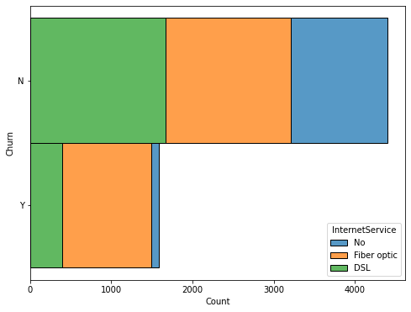
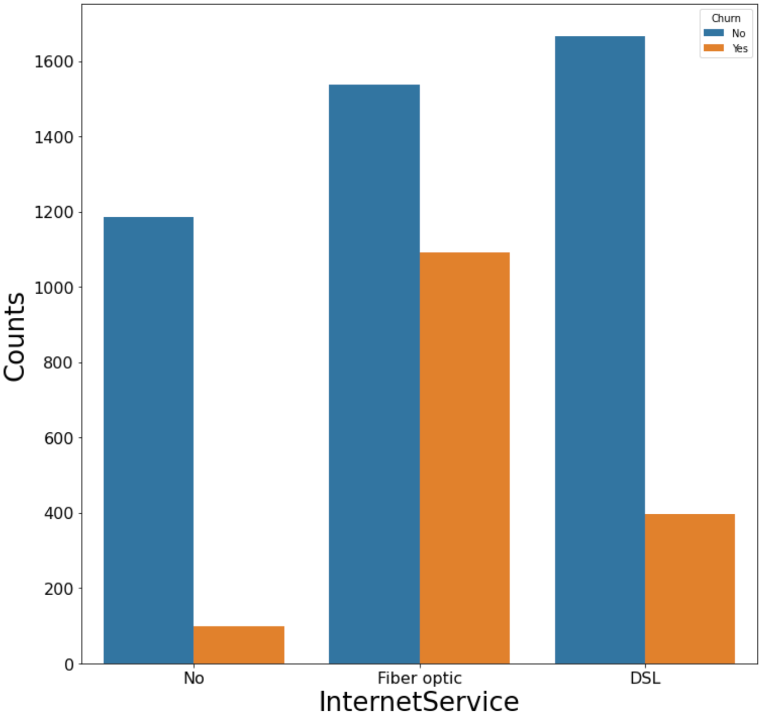
Does the customer have internet?

Slide 25
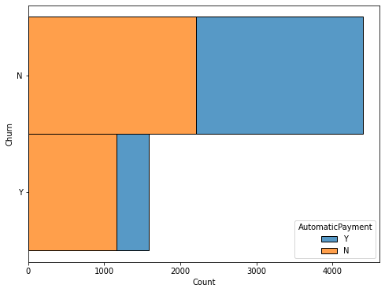
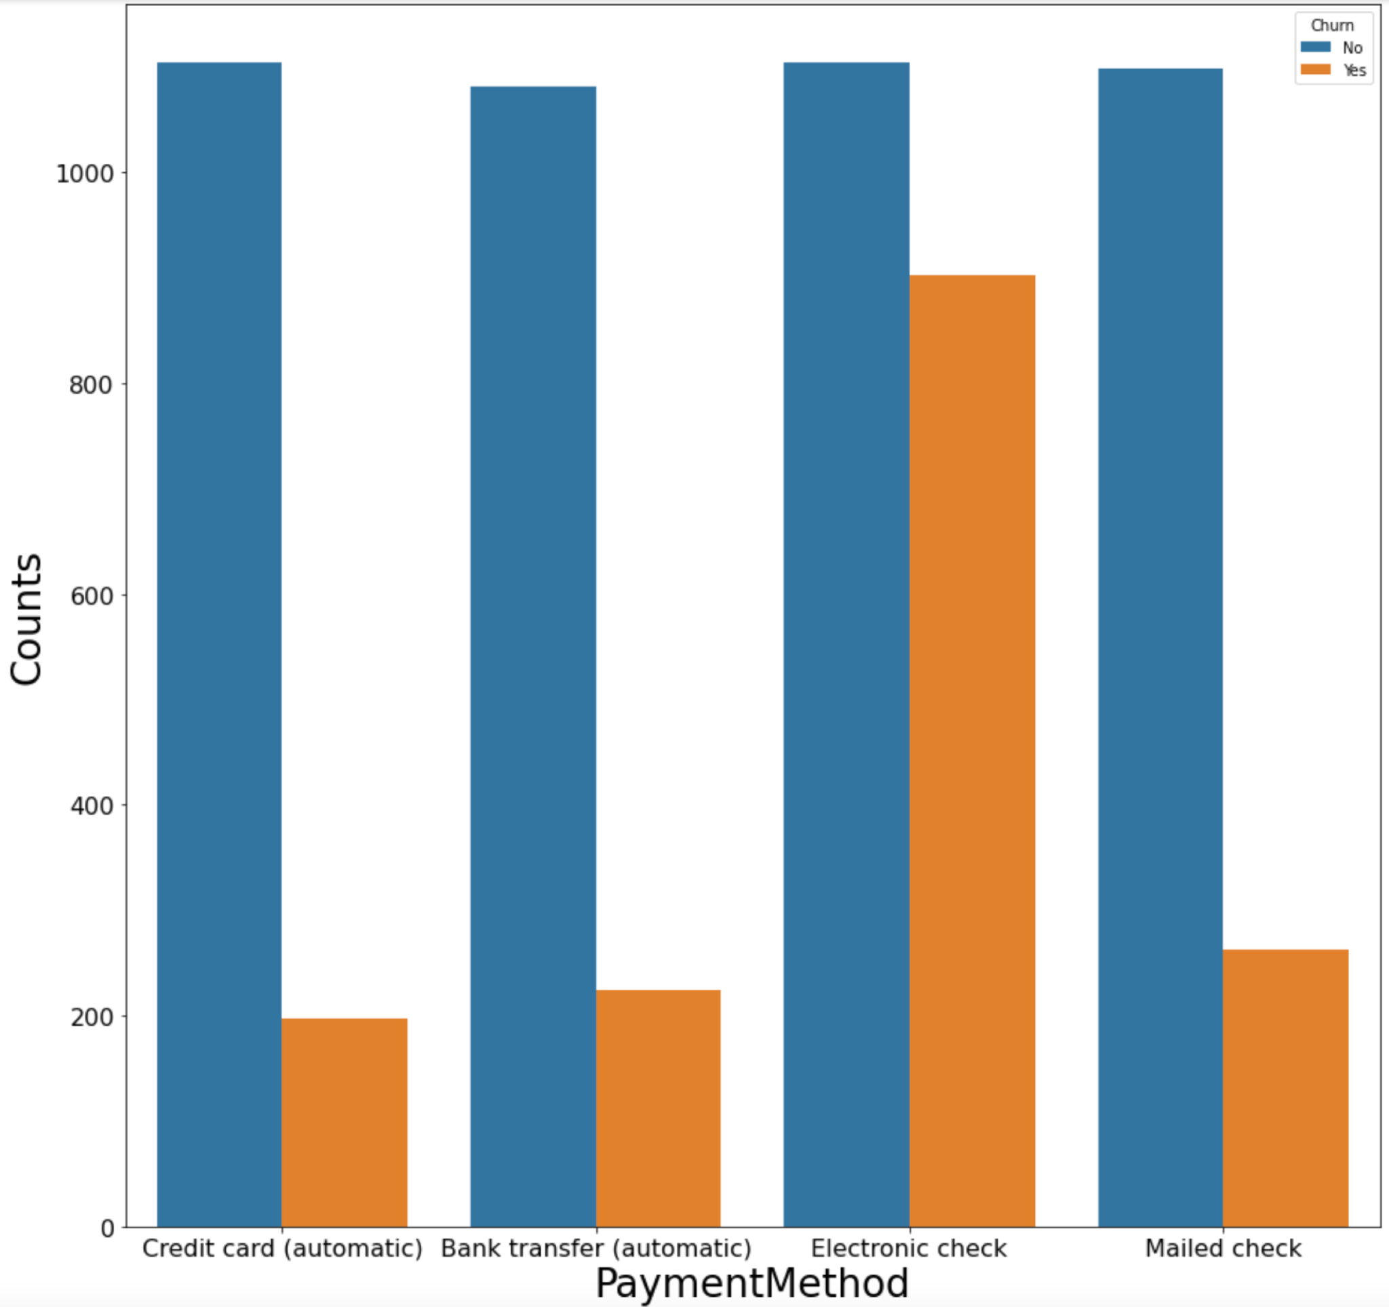
And an automatic payment method?

Slide 26
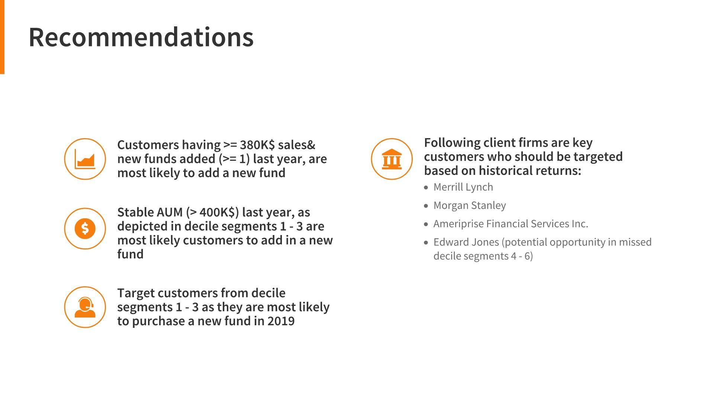
Recommendations
Offer alternative automatic payment methods
Offer a discount in the monthly rate
Extra services (offer internet if the client does not have it)

Slide 27

Q&A

